Slide 1

Videos

Slide 2
Adding Videos to a Web Page
Placing videos into our web pages is not as complicated as it might seem:
Videos can make our pages more interesting and engaging.
Most video-hosting services, such as YouTube, will provide us with HTML code ready to copy and paste into our web page.
Video-embedding code provided to us might not be XHTML valid, requiring us to make some small changes before the page will pass validation.
We also have the option to use our own video files directly on our web pages, but that comes with a number of technical challenges. For this course, we'll only use videos available on YouTube.

Slide 3

YouTube Video
To place a YouTube video into a web page, we first go to the page for the video itself:
Now we can click on Share to view the instructions on how to add it to our own site.

Slide 4
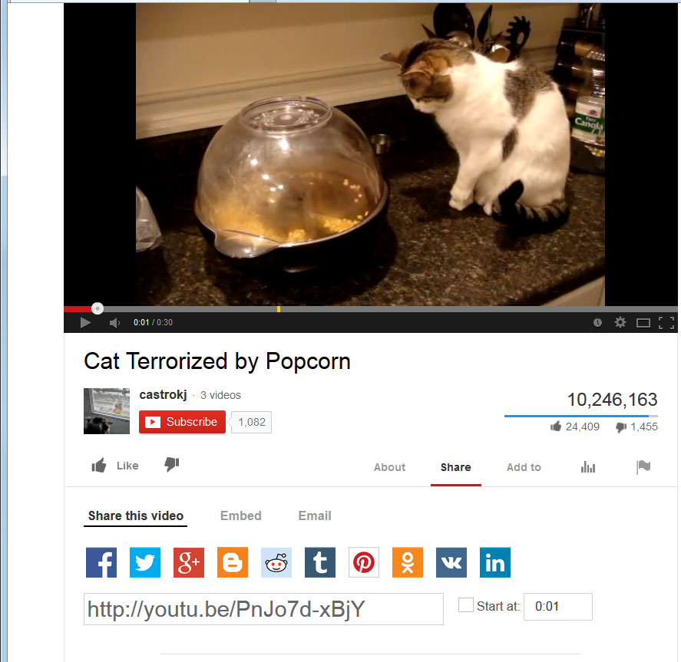
YouTube Video
To get the "copy and paste" code, we now click on the Embed option.

Slide 5
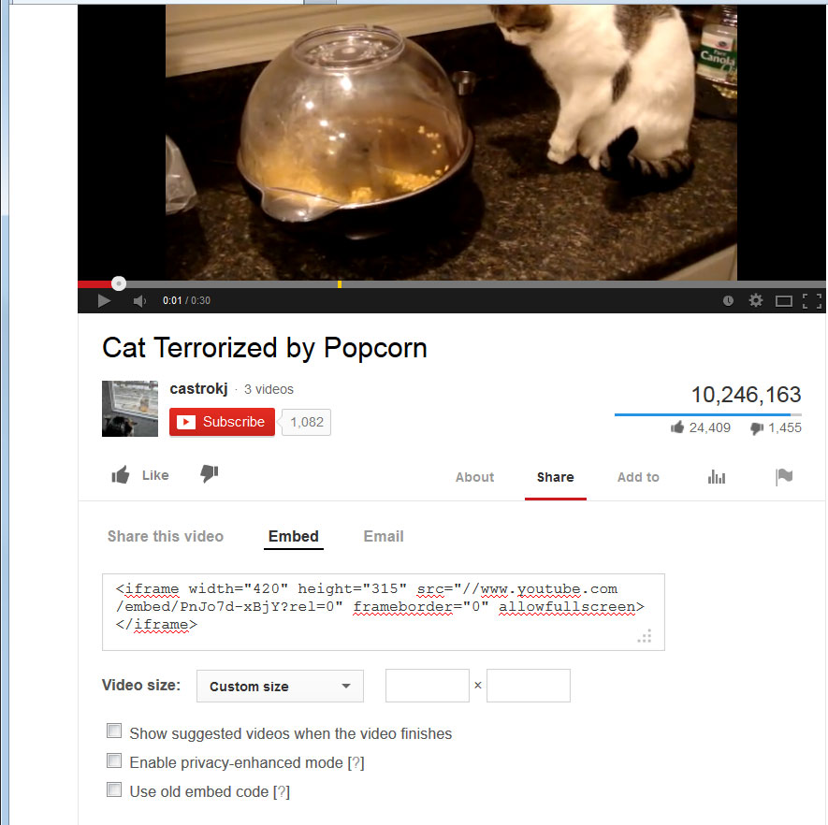
YouTube Video
Now we can copy the HTML code provided and paste it directly into our web document.
YouTube provides us with default dimensions of the video. We can modify those dimensions at this screen or later edit the width and height attributes directly in the code.

Slide 6
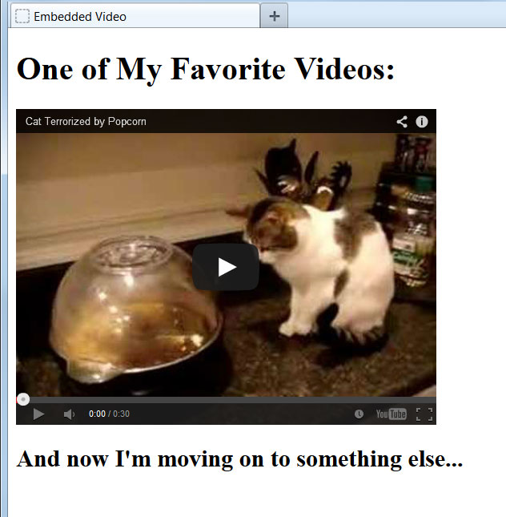
Embedding the Video
Here we've pasted the YouTube code directly between two header elements on our page:
<h1>One of My Favorite Videos:</h1>
<iframe width="420" height="315" src="//www.youtube.com/embed/PnJo7d-xBjY?rel=0" frameborder="0" allowfullscreen></iframe>
<h2>And now I'm moving on to something else...</h2>
The code provided by YouTube will function correctly on a live web server, but if the web document is stored on a local computer, the video will not load. The workaround is to add "http:" at the start of the src attribute value.

Slide 7
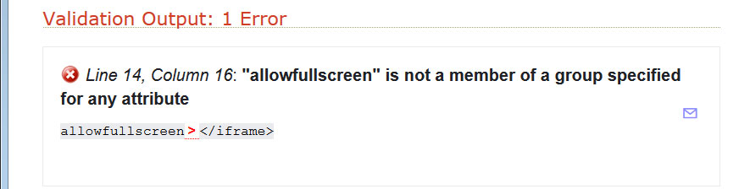
Validating the YouTube Code
When we run the YouTube code through the XHTML validator, we get the following result:
<iframe width="420" height="315" src="//www.youtube.com/embed/PnJo7d-xBjY?rel=0" frameborder="0" allowfullscreen></iframe>
We can fix this just by deleting "allowfullscreen" from the code. This has no effect on the appearance or functionality of our web page but our document will now pass validation.

